Slide 1

AI based diabetes prediction system

Slide 2
Name: k.valarmathi
Department:Biomedicalengineering
3rd year
Project Name:AI based diabetes prediction system

Slide 3
Introduction
Diabetes mellitus is a chronic disease characterized by hyperglycemia. It may cause many complications. According to the growing morbidity in recent years, in 2040, the world’s diabetic patients will reach 642 million, which means that one of the ten adults in the future is suffering from diabetes. There is no doubt that this alarming figure needs great attention. With the development of living standards, diabetes is increasingly common in people’s daily life. Therefore, how to quickly and accurately diagnose and analyze diabetes is a topic worthy studying.

Slide 4

Material and methods
The dataset was obtained from hospital physical examination data in Luzhou, China. This dataset is divided two parts: the healthy people and the diabetes. There are two healthy people physical examination data. We used one of healthy people physical examination data that contains 164431 instances as the training set. In the other data set, 13700 samples were randomly selected as an independent test set

Slide 5
Classification :-
In this section, we used decision tree, RF and neural network as the classifiers. Decision tree and RF can implement in WEKA, which is a free, non-commercial, open source machine learning and data mining software based on JAVA environment. Neural network can be implemented in MATLAB, which is a commercial mathematics software exploited by MathWorks, Inc. It is used for algorithmic development, data visualization, data analysis and provides advanced computational language, and interactive environment for numerical calculation
Real time IoT based processing of health care data:-
Real-time diabetes prediction is a complicated task. The emerging use of sensors in healthcare paved the path to handle fatal diseases . Several techniques have been presented in the literature to classify and predict diabetes. Acciaroli et al. exposed two accurate meters to measure diabetes in blood with less error rate. Furthermore, these commercial versions of glucometers are Accu-Chek with 6.5% error and CareSens with 4.0% error. Buckingham et al. described the accuracy link of CGM with the calibration sensor. Alfian et al. uncovered that the FDA had accepted CGM sensors for monitoring glucose in different trends and patterns. Moreover, at one particular time, one glucose reading should not be used to analyze the amount of insulin as not accepted in a glucometer.

Slide 6
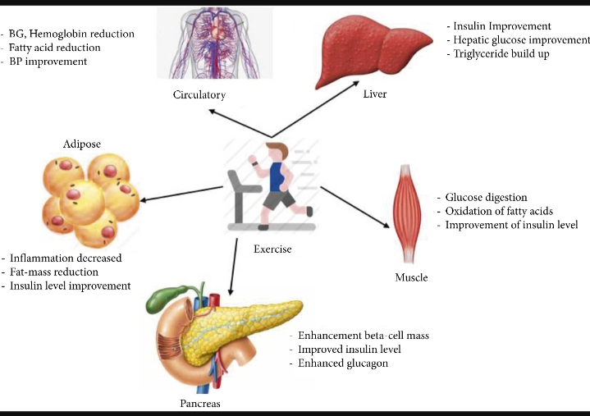
Impact of regular exercise on metabolism of diabetic patients :-

Slide 7
Diabetes classification algorithm
Diabetes classification algorithm using MLP for healthcare.
Input: No. of pregnancies, BG, BP, skin thickness, BMI, age, weight, HB
Output: A Trained Diabetes Classification Model
Method: Initialize all weights to a small random number
while (EER ≤ Threshold) do
for all Training examples, do
Input training example to the network & compute output;
end for
for all output unit k, do
end for
for all hidden unit h do
end for
Update each network weight ;
= ;
End
About Us
Contact us
Partnerships
Blog
Journals
Article Processing Charges
Print editions
Authors
Editors
Reviewers
Partnerships
Hindawi XML Corpus
Open Archives Initiative
Fraud prevention
Follow us:

Slide 8
Achieved Results of Diabetic Prediction Techniques
For diabetic prediction, we implemented three state-of-the-art algorithms, i.e., linear regression, moving averages, and LSTM. Notably, we fine-tuned LSTM and compared its performance with other algorithms. It is evident from Figure 7 and Table 6 that the LSTM outperformed as compared to other algorithms implemented in this study.

Slide 9
tHANK YOU!

